Slide 1
Analysis of Algorithms

Slide 2
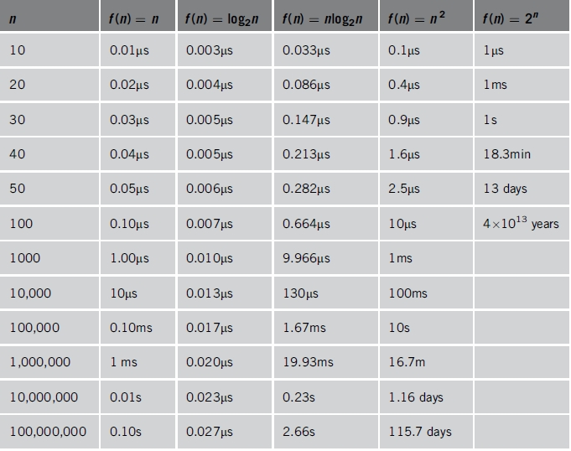
Time for instructions on a computer that executes 1 billion instructions per second

Slide 3
Time and space
Analyzing an algorithm means:
developing a formula for predicting how fast an algorithm is, based on the size of the input (time complexity), and/or
developing a formula for predicting how much memory an algorithm requires, based on the size of the input (space complexity)
Usually time is our biggest concern
Most algorithms require a fixed amount of space

Slide 4
What does “size of the input” mean?
If we are searching an array, the “size” of the input could be the size of the array
If we are merging two arrays, the “size” could be the sum of the two array sizes
If we are computing the n^{th} Fibonacci number, or the n^{th} factorial, the “size” is n
We choose the “size” to be a parameter that determines the actual time (or space) required

Slide 5
Exact values
It is sometimes possible, in assembly language, to compute exact time and space requirements
We know exactly how many bytes and how many cycles each machine instruction takes
For a problem with a known sequence of steps (factorial, fibonacci), we can determine how many instructions of each type are required
However, often the exact sequence of steps cannot be known in advance
The steps required to sort an array depend on the actual numbers in the array (which we do not know in advance)

Slide 6
Higher-level languages
In a higher-level language, we do not know how long each operation takes
Which is faster, x < 10 or x <= 9 ?
We don’t know exactly what the compiler does with this
The compiler almost certainly optimizes the test anyway (replacing the slower version with the faster one)
In a higher-level language we cannot do an exact analysis
Our timing analyses will use major oversimplifications
Nevertheless, we can get some very useful results

Slide 7
Average, best, and worst cases
Usually we would like to find the average time to perform an algorithm
However,
Sometimes the “average” isn’t well defined
Example: Sorting an “average” array
Time typically depends on how out of order the array is
How out of order is the “average” unsorted array?
Sometimes finding the average is too difficult
Often we have to be satisfied with finding the worst (longest) time required
Sometimes this is even what we want (say, for time-critical operations)
The best (fastest) case is seldom of interest

Slide 8
Constant time
Constant time means there is some constant k such that this operation always takes k nanoseconds
A statement takes constant time if:
It does not include a loop
It does not include calling a method whose time is unknown or is not a constant
If a statement involves a choice (if or switch) among operations, each of which takes constant time, we consider the statement to take constant time
This is consistent with worst-case analysis

Slide 9
Example
Consider the following algorithm. (Assume that all variables are properly declared.)
 | Line | # of operations
cout << "Enter two numbers"; cin >> num1 >> num2; if (num1 >= num2) max = num1; else max = num2; cout << "The maximum number is: " << max << endl; | 1 2 3 4 5 6 7 | 1 2 1 1 1 3
Either Line 4 or Line 6 executes. Therefore, the total number of operations executed is 1 + 2 + 1 + 1 + 3 = 8. In this algorithm, the number of operations executed is fixed.

Slide 10
Linear time
We may not be able to predict to the nanosecond how long a program will take, but do know some things about timing:
for (i = 0, j = 1; i < n; i++) { j = j * i; }
This loop takes time k*n + c, for some constants k and c
k : How long it takes to go through the loop once (the time for j = j * i, plus loop overhead)
n : The number of times through the loop (we can use this as the “size” of the problem)
c : The time it takes to initialize the loop
The total time k*n + c is linear in n

Slide 11
Example
 | Lines | # of operations
sum = 0; num = 10; while (num != -1) { sum = sum + num; num = num -1; } cout << sum; | 1 2 3 4 5 6 7 8 | 1 1 1 2 2 1
If the while loop executes n times, the number of operations executed is: 5n + 4.

Slide 12
Cont.
n | 5n+4
10 | 54
100 | 504
1000 | 5004
10000 | 50004
For very large values of n, the term 5n becomes the dominating term and the term 4 become negligible.

Slide 13
Constant time is (usually) better than linear time
Suppose we have two algorithms to solve a task:
Algorithm A takes 5000 time units
Algorithm B takes 100*n time units
Which is better?
Clearly, algorithm B is better if our problem size is small, that is, if n < 50
Algorithm A is better for larger problems, with n > 50
So B is better on small problems that are quick anyway
But A is better for large problems, where it matters more
We usually care most about very large problems
But not always!

Slide 14
What about the constants?
An added constant, f(n)+c, becomes less and less important as n gets larger
A constant multiplier, k*f(n), does not get less important, but...
Improving k gives a linear speedup (cutting k in half cuts the time required in half)
Improving k is usually accomplished by careful code optimization, not by better algorithms
We aren’t that concerned with only linear speedups.
Bottom line: Forget the constants!

Slide 15
Simplifying the formulae
Throwing out the constants is one of two things we do in analysis of algorithms
By throwing out constants, we simplify 12n² + 35 to just n²
Our timing formula is a polynomial, and may have terms of various orders (constant, linear, quadratic, cubic, etc.)
We usually discard all but the highest-order term
We simplify n² + 3n + 5 to just n²

Slide 16
Big O notation
When we have a polynomial that describes the time requirements of an algorithm, we simplify it by:
Throwing out all but the highest-order term
Throwing out all the constants
If an algorithm takes 12n³+4n²+8n+35 time, we simplify this formula to just n³
We say the algorithm requires O(n³) time
We call this Big O notation

Slide 17
Can we justify Big O notation?
Big O notation is a huge simplification; can we justify it?
It only makes sense for large problem sizes
For sufficiently large problem sizes, the highest-order term swamps all the rest!
Consider R = x² + 3x + 5 as x varies:
x = 0 x² = 0 3x = 0 5 = 5 R = 5
x = 10 x² = 100 3x = 30 5 = 5 R = 135
x = 100 x² = 10000 3x = 300 5 = 5 R = 10,305
x = 1000 x² = 1000000 3x = 3000 5 = 5 R = 1,003,005
x = 10,000 x² = 10⁸ 3x = 3*10⁴ 5 = 5 R = 100,030,005
x = 100,000 x² = 10¹⁰ 3x = 3*10⁵ 5 = 5 R = 10,000,300,005

Slide 18
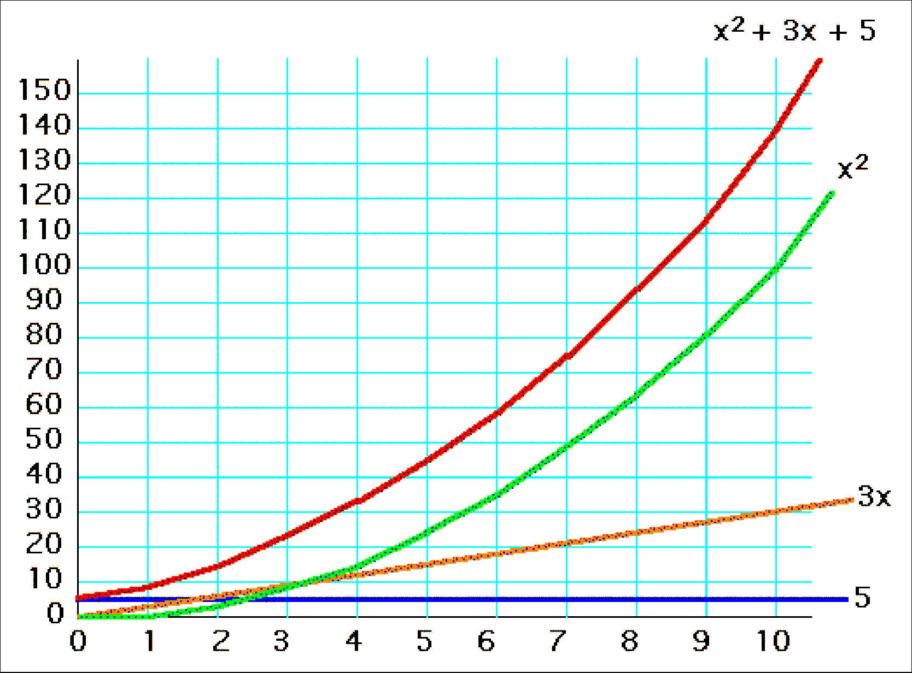
y = x² + 3x + 5, for x=1..10

Slide 19
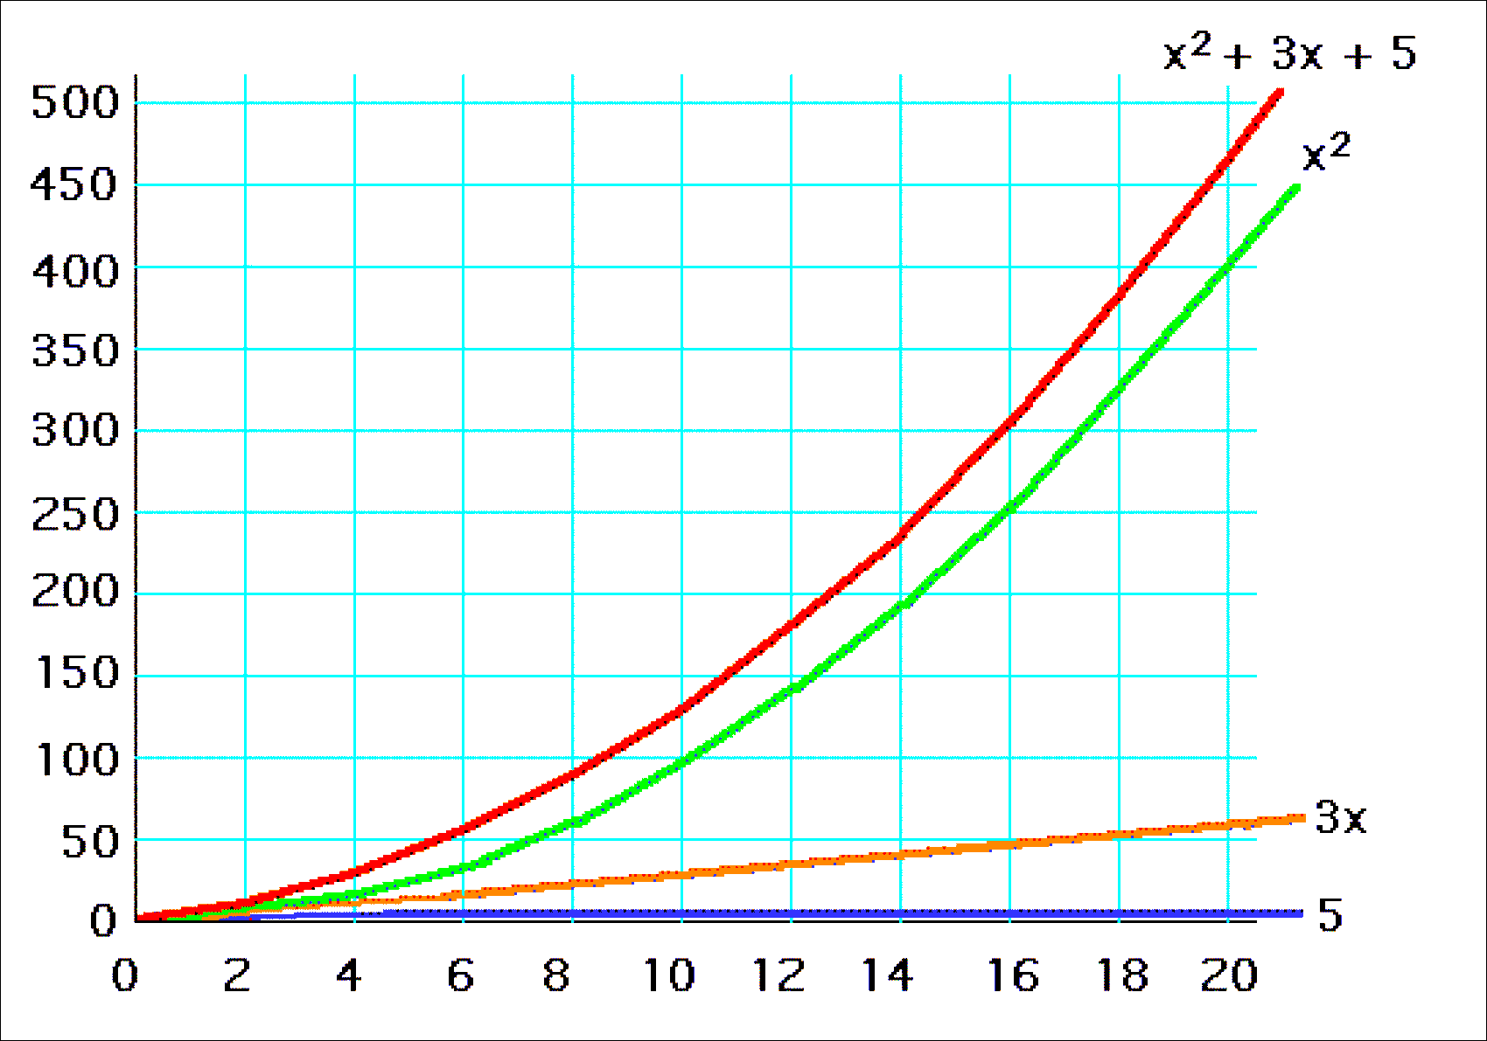
y = x² + 3x + 5, for x=1..20

Slide 20
Common time complexities
BETTER
WORSE
O(1) constant time
O(log n) log time
O(n) linear time
O(n log n) log linear time
O(n²) quadratic time
O(n³) cubic time
O(n^{k}) polynomial time
O(2^{n}) exponential time

Slide 21
NP-complete problem
Hard problem:
Most problems discussed are efficient (poly time)
An interesting set of hard problems: NP-complete.
Why interesting:
Not known whether efficient algorithms exist for them.
If exist for one, then exist for all.
A small change may cause big change.
Why important:
Arise surprisingly often in real world.
Not waste time on trying to find an efficient algorithm to get best solution, instead find approximate or near-optimal solution.
Example: traveling-salesman problem. Given a list of cities and the distances between each pair of cities, what is the shortest possible route that visits each city exactly once and returns to the origin city?

Slide 22


Bjarne Stroustrup
A Danish computer scientist, most notable for the creation and development of C++
“I have always wished for my computer to be as easy to use as my telephone; my wish has come true because I can no longer figure out how to use my telephone”.

Slide 23
Example 1
Find the running time, worst time, complexity, or Big-Oh analysis for the following code
for (i = 0; i < n; i++)
for (j = 0; j < n; j++)
cin >> A[i][j];
Number of times cin >> A[i][j]; executed: n²
Complexity: O (n²)

Slide 24
Example 2
for (i = 0; i <= n; i++)
for (j = 0; j <= i; j++)
A[i][j] = 0;
O(n²)

Slide 25
Example 3
for (i = 0; i < n; i++)
{
for (j = 0; j < n; j++)
A[i][j] = j*2;
for (k = 0; k <2* n; j++)
A[i][k] = k *3;
}
O(n²)

Slide 26
Example 4
for (i = 0; i < n; i++)
{
for (j = 0; j < n; j++)
A[i][j]= i *j;
for (k = 0; k <2* n; k++)
for (m = 0; m <2* n; m++)
sum = sum +1;
}
O(n³)

Slide 27
Example 5
void main()
{
int i,j, tofind, A[100], n = 100;
for (j = 0; j < n; j++)
A[j] = j * 2;
i = 0;
cin >> tofind;
while (A[i] != tofind) i++;
if (i > n)
cout << "not found";
else
cout << "found";
}
O(n)

Slide 28
Summary
http://bigocheatsheet.com/

